Slide 1
COVID-19 Agent Based Modeling

Slide 2
Goals
Accurately simulate epidemiological spread, clinical outcomes and test-seeking to evaluate observational testing datasets
Develop base infrastructure that allows for additional investigation of future COVID19 scenarios of interest e.g. school openings

Slide 3
Goals
Accurately simulate epidemiological spread, clinical outcomes and test-seeking to evaluate observational testing datasets
Baseline infrastructure that allows for additional investigation of future COVID19 scenarios of interest e.g. school openings

Slide 4
Goals
Accurately simulate epidemiological spread, clinical outcomes and test-seeking to evaluate bias in observational testing datasets
Known heterogeneities in testing across demographics (age, race), geographies (zip codes/census tracts), clinical outcomes (asymptomatic, mildly symptomatic, hospitalized)
ABM should simulate:
Testing location (hospitals, private clinics, public testing facilities, nursing homes) in relation to residence
Symptoms and contacts, with variability by age, race, SES

Slide 5
Challenges
Trade off between realism and complexity
Lines of code and compute time
Accurate & objective representation of agent behaviors
Particularly w.r.t. location/contact and test-seeking

Slide 6
Approaches
Matrix-based contact network
Worked well for small-n (e.g. safe-campus study)
Matrices become too large, slow at scale (1e6 agents= 1e6^2 matrix entries)
FRED-inspired simulation of contact
Determine location of each agent at each time step, simulate infection within location(s) that contain infectious agent(s)
Agents stored in data.table: fast subsetting and updating, but still slow if individual agent function(s) slow
Agent info overridden in each time step, so any data for analysis must be pulled out and stored separately
Currently population infection, testing, and infected individuals

Slide 7
Approaches, Agents
Synthetic agents database for SF county developed by RTI
https://www.rti.org/brochures/rti-us-synthetic-household-population%E2%84%A2-database
Downloaded from https://fred.publichealth.pitt.edu/syn_pops
People (age, sex, race/ethnicity)
Households with location and HH income ; linkable to people
Placed in neighborhoods based on 10km hexagonal grid (~15,000 neighborhoods)
Group quarters (dorms, nursing facilities, prisons, military barracks)
Schools with location ; linkable to people
Schools divided into classrooms with similarly aged individuals
Workplaces with location ; linkable to people
Workplaces divided into offices

Slide 8
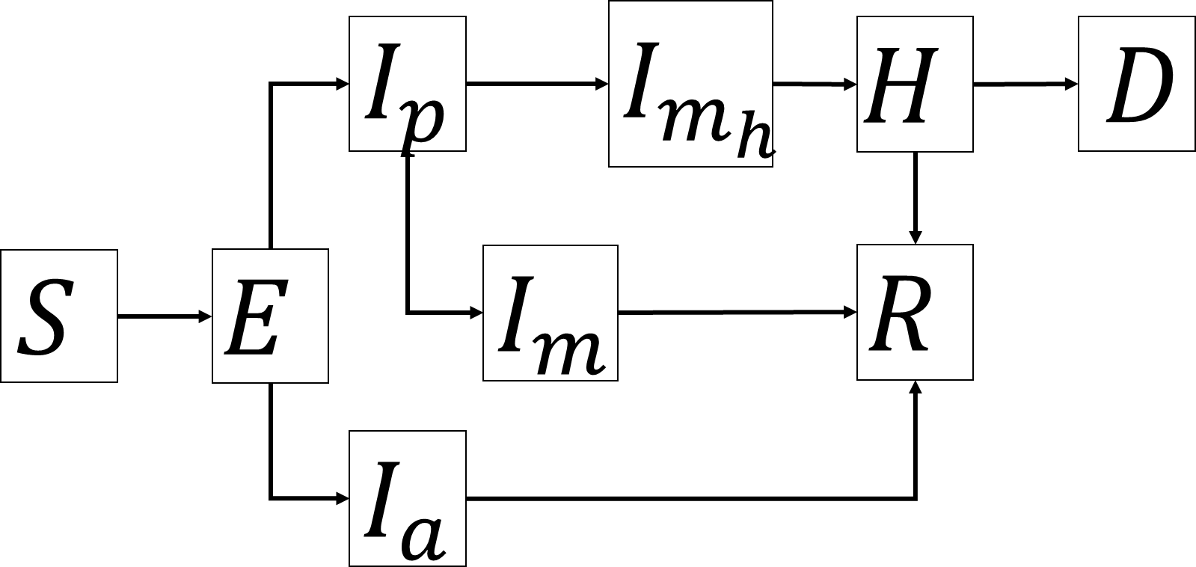
Approaches, Epidemiological model
SEIR model with similar structure to LEMMA
Age-dependent transition probabilities
Random draws for transition times

Slide 9
Approaches, Contact model
Location influenced by:
Agent-type (school-aged child, working adult, group quarters resident)
Infection state
Tested state
Time of day (4-hr timestep: night x2, morning, day x2, evening)
Weekday vs weekend
School closure in effect
Shelter-in-Place in effect
Neighborhood median HH income quartile
Sociality
* Movement data such as Safetrac?

Slide 10
Approaches, Contact model
Basically a branching process model that ends in a decision for each agent
School-aged child:
Symptoms or tested positive?
0
Daytime?
1
Weekend?
0
Schools Closed?
0
School
0
1
1
1
Nighttime?
0
Home/
Community
1
Home
SiP, Age, Sociality, Neighborhood income

Slide 11
Approaches, Contact model
Currently revising to simplify logic. Know of any fast branching process packages/implementations?
Wishlist:
Essential workers
Crudely implemented at the moment as probability essential given workplace income
Nursing facility and prison workers
Currently implemented by assigning workers at workplace closest to group quarters facility as working at that facility
Healthcare workers
Those that interact with hospitalized patients
Those that interact with people getting tested
What is infection risk?
School workers (i.e. teachers) to investigate school closures

Slide 12
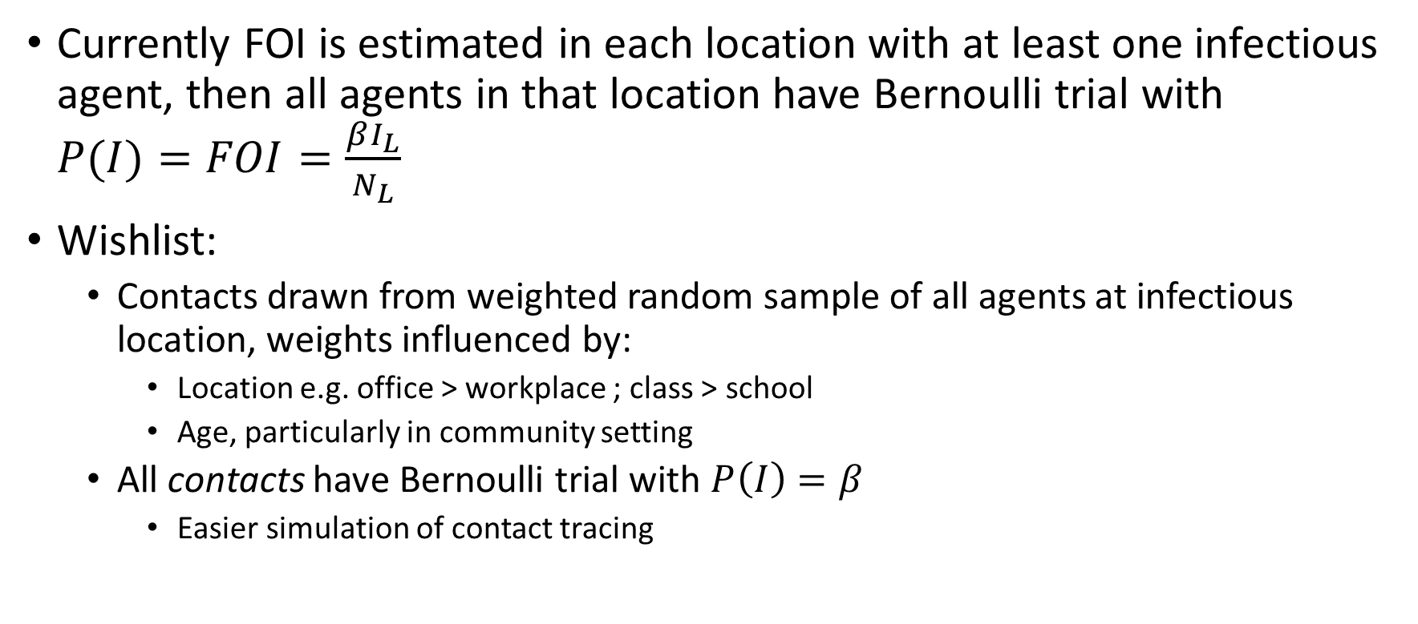
Approaches, Infection|Contact model
Currently FOI is estimated in each location with at least one infectious agent, then all agents in that location have Bernoulli trial with $P(I)=FOI=\frac{βI_{L}}{N_{L}}$
Wishlist:
Contacts drawn from weighted random sample of all agents at infectious location, weights influenced by:
Location e.g. office > workplace ; class > school
Age, particularly in community setting
All contacts have Bernoulli trial with $P\left(I\right)=β$
Easier simulation of contact tracing

Slide 13
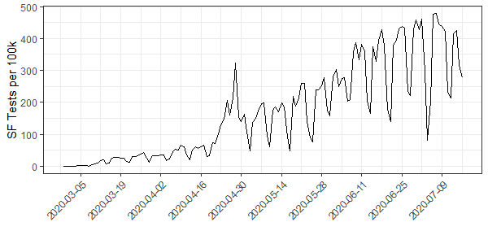
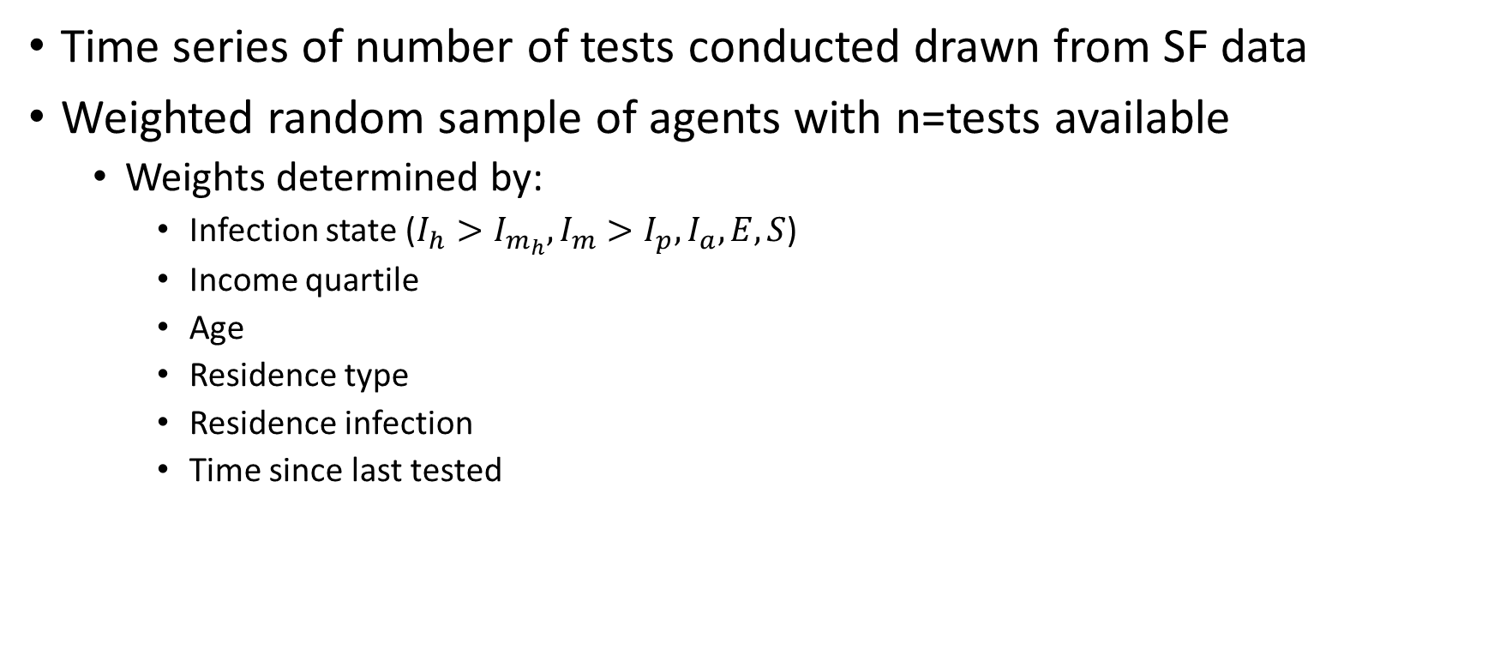
Approaches, Testing model
Time series of number of tests conducted drawn from SF data
Weighted random sample of agents with n=tests available
Weights determined by:
Infection state ($I_{h}>I_{m_{h}},I_{m}>I_{p},I_{a},E,S$)
Income quartile
Age
Residence type
Residence infection
Time since last tested

Slide 14
Approaches, Testing model
Wishlist:
Testing at different facilities
Tests per facility + catchment of test facilities could influence which agents are tested
Background rate of all-cause/ILI hospitalizations to inform tests performed at hospitals
Background rate of other illnesses to inform agent-test seeking (e.g. flu, other coronaviruses, streptococcus, etc.)

